Slide 1
CREATING CONTENT THAT MATTERS
SUSAN WENNER JACKSON

Slide 2
A LITTLE ABOUT ME
Childhood dream: Publish a magazine
Career spanning journalism, PR, social media, marketing
WordPress blogger since 2009
Cincinnati Blogging Meetup

Slide 3
A LITTLE ABOUT YOU
…?

Slide 4
WHAT WE’LL COVER TODAY
Identify your focus
Choose your medium
Make a plan
Get the word out
Close the deal

Slide 5
GET THIS ON SLIDESHARE
http://bit.ly/wccincy-content

Slide 6
IDENTIFY YOUR FOCUS
Decide which content areas or niche to concentrate on.

Slide 8
IDENTIFY YOUR FOCUS
Your passion
Your purpose
Your audience
Current marketplace: What’s missing?

Slide 9
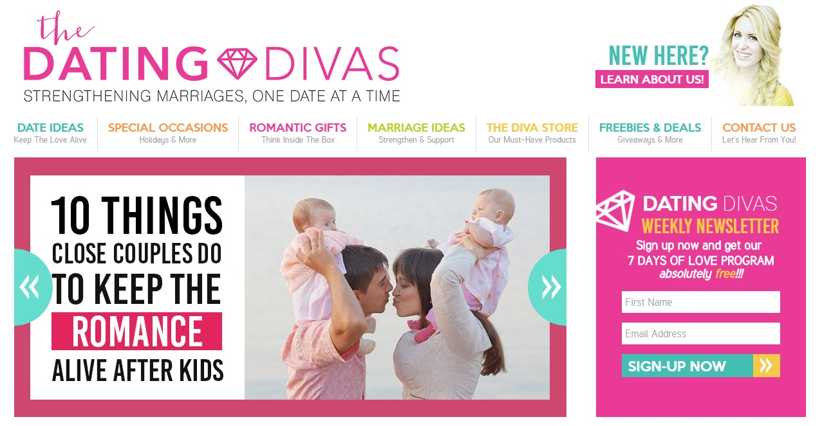

Slide 10
WORDPRESS TIP
RESOURCE
15 questions to ask yourself when choosing a focus:
http://problogger.com/podcast/59-2/
Use CATEGORIES and TAGS to organize your posts and hone your content focus.

Slide 11
CHOOSE YOUR MEDIUM
Pick the platforms or formats that work best for you and your audience.

Slide 13
CHOOSE YOUR MEDIUM
What are your strengths?
What tools and resources are available?
What do you want to learn?
Consider the senses

Slide 14
CHOOSE YOUR MEDIUM: EXAMPLES
Video
Podcast
Photography
Illustration
Written article
Infographic
Webinar
Online course
E-book
Email
Live event
Slide show

Slide 15
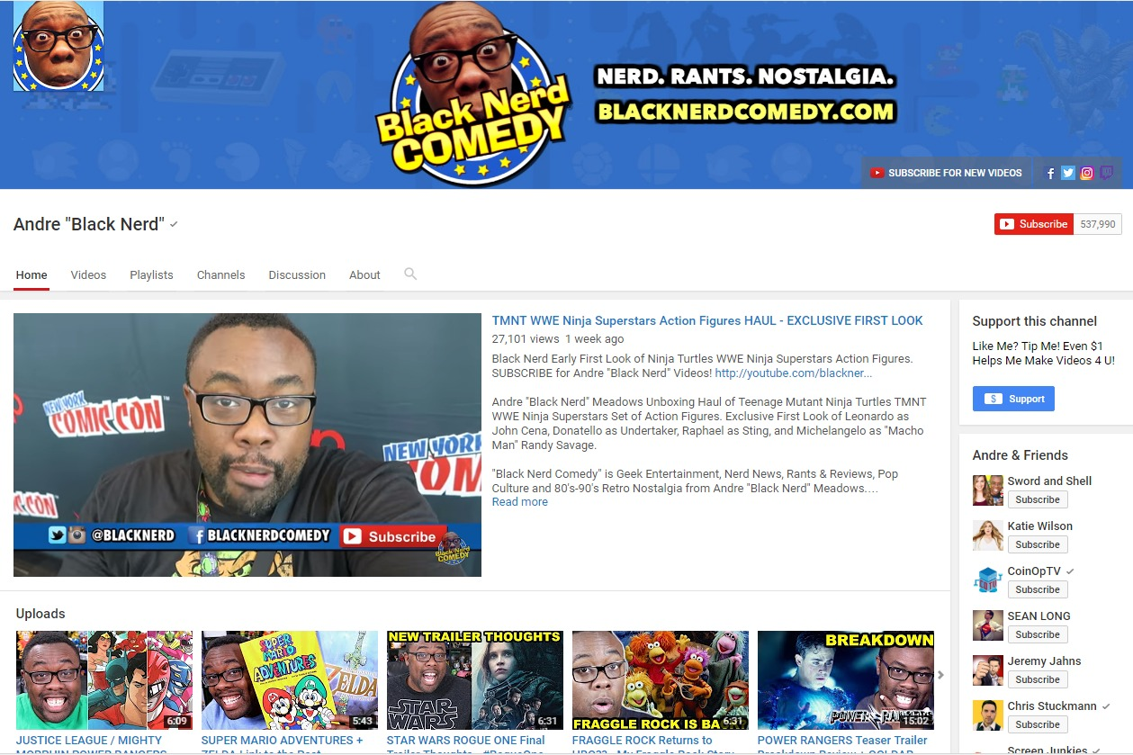

Slide 16
WORDPRESS TIP
RESOURCE
Get inspiration and tips for various content types and platforms:
http://iblogmagazine.com/
EMBED content from other platforms to keep your WordPress site the hub and spark engagement.

Slide 17
MAKE A PLAN
Develop an editorial calendar to map out content creation and promotion.

Slide 19
MAKE A PLAN
Consolidate
Consider seasonality, holidays, themes, trends
Publishing: new and updated
Promotion

Slide 20
WORDPRESS TIP
RESOURCE
Get more ideas and free templates:
http://coschedule.com/editorial-calendar-template
Hands-down, CoSchedule makes the best editorial calendar plugin for WordPress. WORTH THE $!

Slide 21
GET THE WORD OUT
Distribute your content to the audience you want to reach.

Slide 23
GET THE WORD OUT
Once is not enough
Reach your audience with frequency and variety
Tap the power of automation
Make it easy for fans to share
Invest when it makes sense

Slide 24
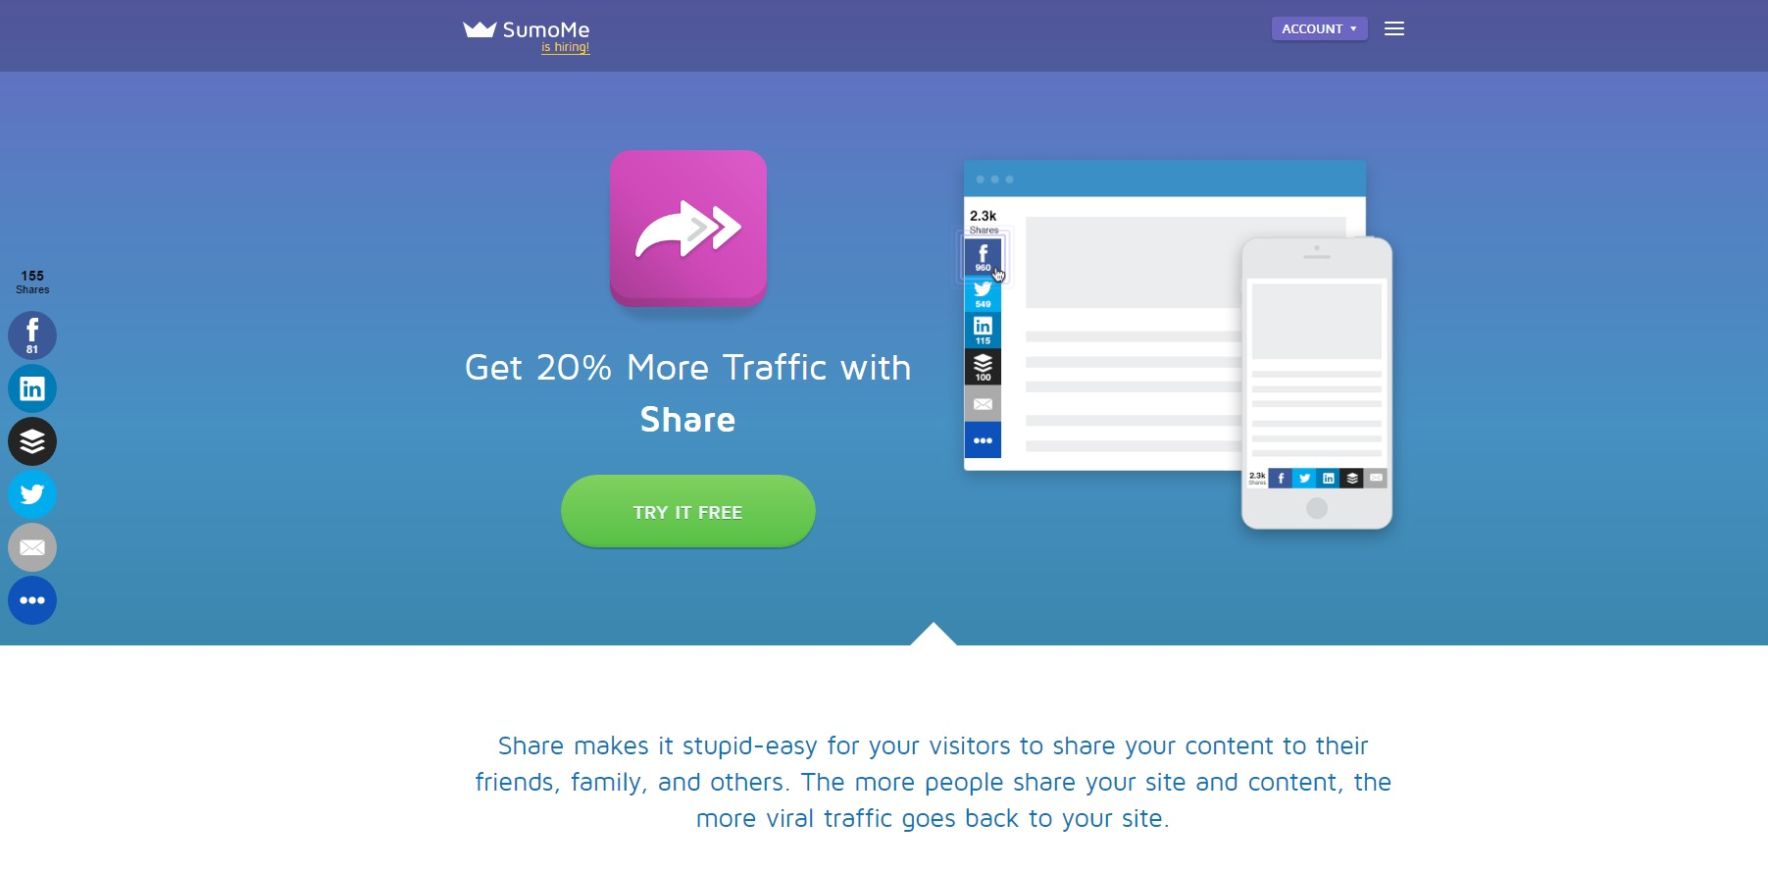

Slide 25
WORDPRESS TIP
RESOURCE
Create a social marketing strategy from scratch:
https://blog.bufferapp.com/ social-media-marketing-plan
Organize and maximize your existing content for marketing and more with WP ALL EXPORT plugin.

Slide 26
CLOSE THE DEAL
Harness the power of content to achieve your goals.

Slide 27
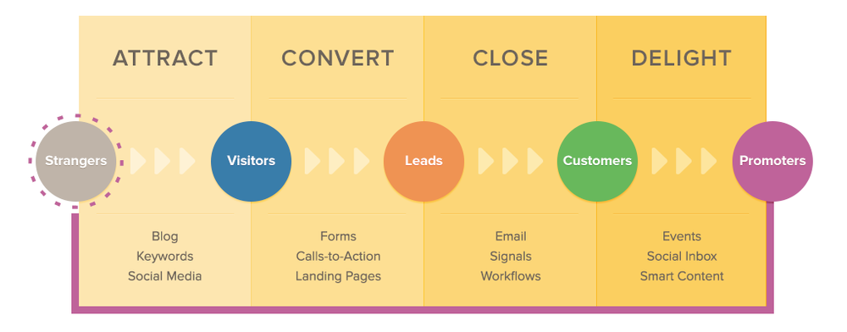

Slide 28
CLOSE THE DEAL
What’s your end game?
80/20 rule: 80% value, 20% sell
Be authentic, helpful, honest

Slide 29
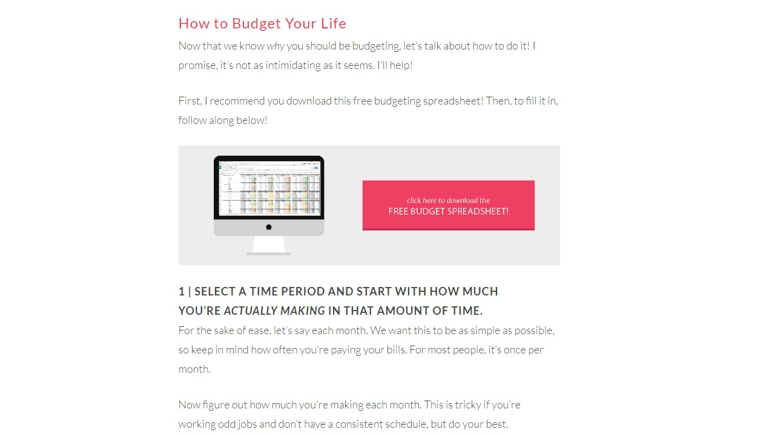

Slide 30
WORDPRESS TIP
RESOURCE
Get Google Analytics WD Plugin to serve up key insights right to your dashboard:
https://web-dorado.com/products/ wordpress-google-analytics-plugin.html
Use DATA to evaluate which content and methods produce best ROI.

Slide 31
QUICK REVIEW
Identify your focus
Choose your medium
Make a plan
Get the word out
Close the deal
http://bit.ly/wccincy-content

Slide 32
LET’S CONNECT
SusanWennerJackson.com
WorkingMomsAgainstGuilt.com
@susanwjackson
meetup.com/Cincinnati-Blogging-Meetup/
susanwennerjackson@gmail.com

